Slide 1
ARTIFICIAL NEURAL NETWORKS
MRUDUL KATLA

Slide 2
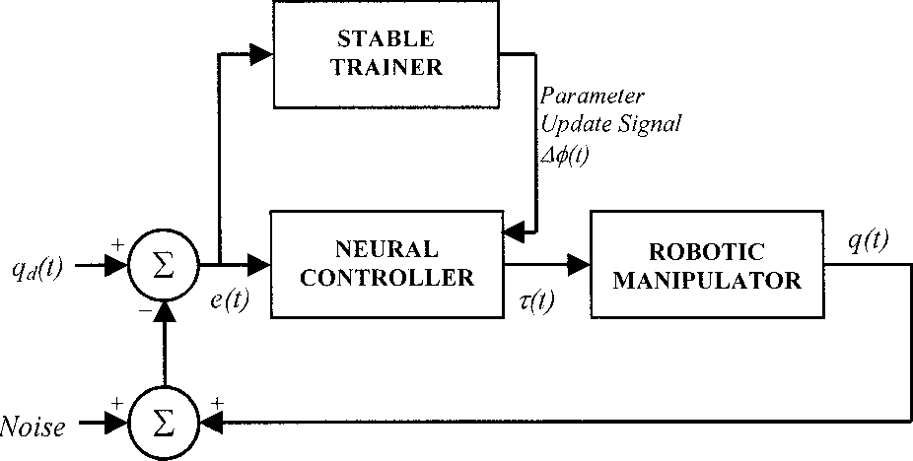
APPLICATION

Slide 3

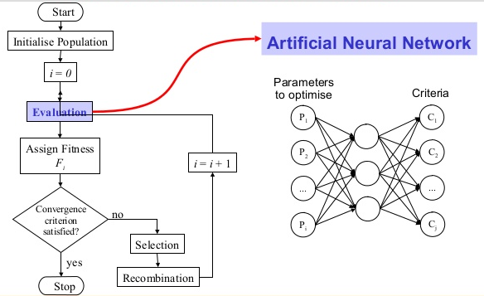
CREATING DATASET USING GA

